Slide 1

Other Fun things to do with a Raspberry Pi

Slide 2
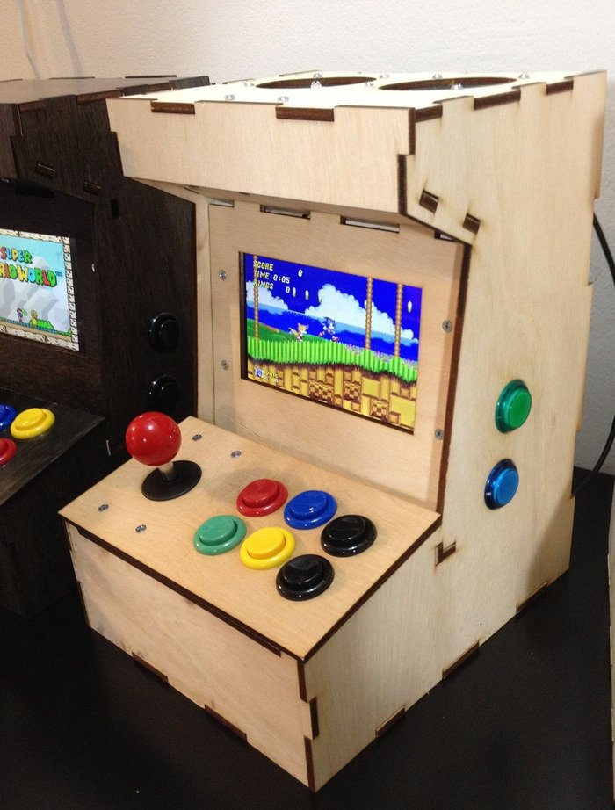
Pi Arcade

Slide 3
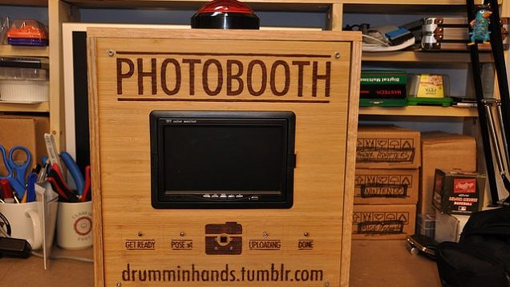
Photobooth

Slide 4
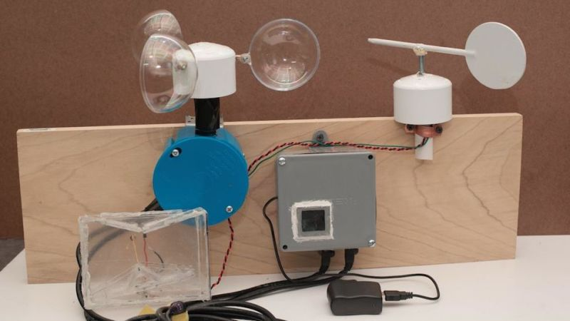
Weather Station

Slide 5
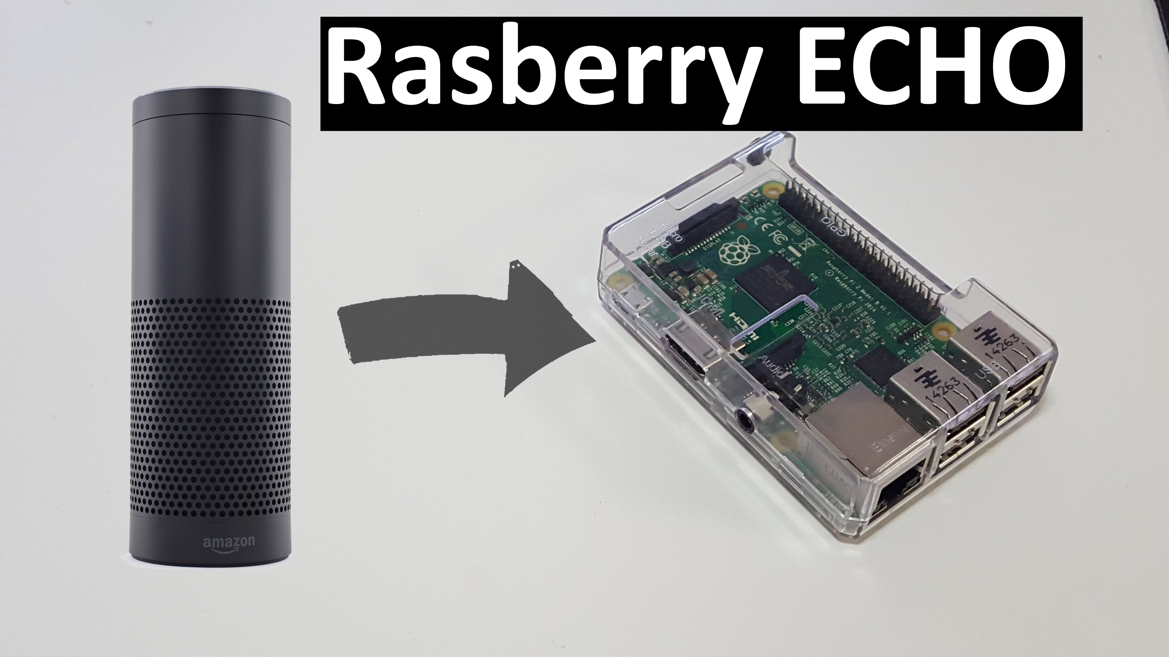
Pi Echo

Slide 6
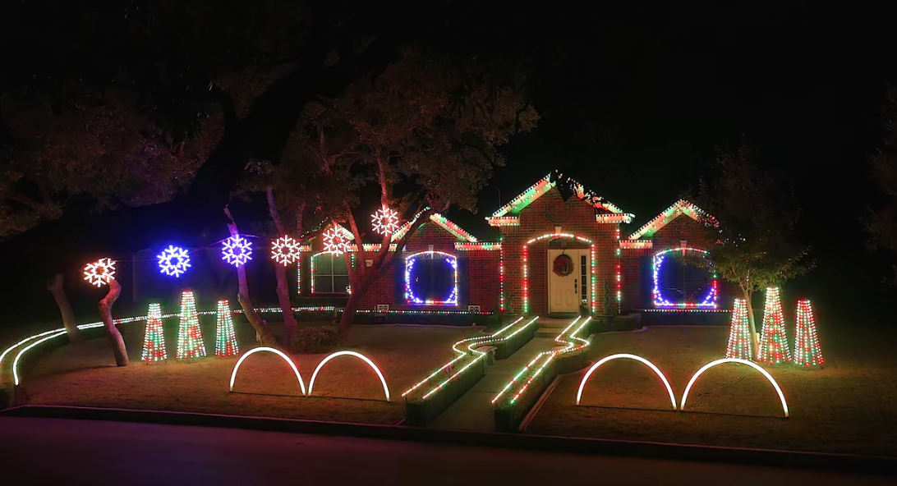
Christmas Lights

Slide 7
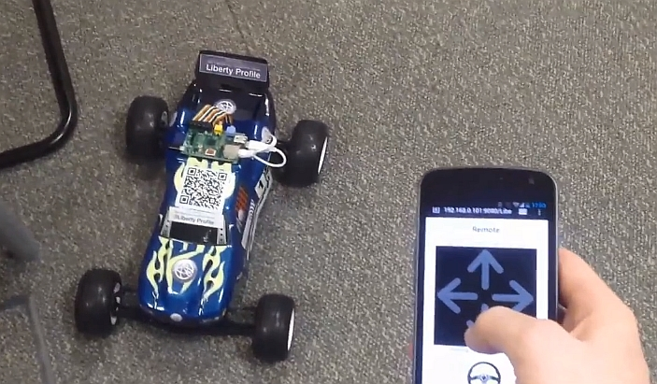
Remote Controlled Car

Slide 8
Useful Links
https://www.raspberrypi.org
https://www.adafruit.com
https://shop.pimoroni.com/collections/raspberry-pi
https://thepihut.com

